Slide 1
Project Management Fundamentals
Unit 2

Slide 2

2.1 Project Selection and Planning
Selection methodologies and criteria for project approval.
Project planning: time, schedule and cost.
2.2 Project Methodologies
Traditional verses Agile methodologies.
Choosing the appropriate project management methodology.
2.3 Managing and Controlling Projects
Managing scope, time, and resources.
Staffing and coordinating project activities.
Risk management strategies.
2.4 Project Management Tools
Use of work breakdown structure (WBS), Gantt charts, Critical Path Method (CPM), and Program evaluation review technique (PERT).
Earned value management (EVM) and Key performance indicators (KPIs) for project monitoring and control

Slide 3

Project selection and planning are essential steps in System Analysis and Design (SAD).
Here's an overview of these processes:
Project Selection
Project selection is the process of identifying a project that aligns with organizational goals and adds value.
It involves assessing different ideas or needs and determining which project should proceed to the next phase.
Steps include:
Identifying Business Needs: Understand the problems or opportunities that need to be addressed. This could come from internal departments, customers, or market demands.

Slide 4
Feasibility Analysis: Evaluate technical, economic, and operational feasibility.
This helps determine if the project can be done within the organization's resources, budget, and time constraints.
Technical Feasibility: Assess if the current technology can support the project.
Economic Feasibility: Determine if the project is cost-effective.
Operational Feasibility: Ensure that the project will operate as intended and meets the business goals.
Prioritization:
Compare different projects based on their benefits, costs, and risks.
Tools like scoring models and cost-benefit analysis can help in prioritizing.

Slide 5
Project Planning
Once a project is selected, detailed planning is required to set clear directions and ensure successful execution.
This involves:
Defining Scope and Objectives:
Clearly outline what the project will deliver and the key goals it aims to achieve. This helps in avoiding scope creep.
Work Breakdown Structure (WBS): Break down the project into smaller, manageable tasks or work packages. This helps in organizing tasks and tracking progress.
Scheduling: Determine the timeline for each task, including start and end dates. Gantt charts and network diagrams can be useful here.

Slide 6
Resource Allocation: Identify and assign the necessary resources (human, equipment, financial) to tasks.
Risk Management: Identify potential risks and develop strategies to mitigate them. Creating a risk management plan helps in proactive management of challenges.
Budget Planning: Estimate the costs associated with different tasks and resources, and prepare a budget that aligns with the project’s financial constraints.
Communication Plan: Develop a plan for how information will be communicated to stakeholders, including team members, management, and clients.
Monitoring and Evaluation: Define metrics to monitor the project's progress and evaluate its success. This can include performance indicators, project milestones, and regular progress reviews.

Slide 7
Selection methodologies and criteria for project approval
Selection methodologies and criteria for project approval are essential for determining which projects should move forward.
Different methodologies help organizations prioritize projects based on various factors like strategic alignment, feasibility, and potential return on investment.
Here are some common methodologies and criteria used in project selection and approval:
1. Selection methodologies
Several methodologies are used to evaluate and select projects.
The choice of methodology depends on the organization's needs and strategic goals ,some of them are:
a. Cost-Benefit Analysis
Description: This method involves comparing the costs of the project against its expected benefits.
It is used to determine if the benefits justify the investment.

Slide 8
Application: Calculate the total costs (direct and indirect) and compare them with the potential financial and non-financial benefits. Projects with a higher net benefit are prioritized.
b. Scoring Models
Description: Scoring models assign weights and scores to various criteria (e.g., cost, time, risk, strategic alignment) and calculate a total score for each project.
Application: Define selection criteria, assign weights based on importance, and score projects accordingly. Projects with the highest scores are prioritized.
c. Payback Period
Description: The payback period method calculates the time it takes for a project to recover its initial investment.
Application: Projects with shorter payback periods are often preferred because they allow organizations to recover their investments quickly.

Slide 9
d). Net Present Value (NPV)
Description: NPV measures the profitability of a project by calculating the difference between the present value of cash inflows and outflows over a period of time.
Application: Projects with a higher NPV are more financially viable and are given priority.
e). Internal Rate of Return (IRR)
Description: IRR is the interest rate at which the net present value of the project's cash flows equals zero.
It represents the project's profitability.
Application: Projects with higher IRRs are more attractive and are selected.
f). Strategic Alignment
Description: Projects are selected based on how well they align with the organization’s strategic goals and objectives.
Application: Projects that contribute directly to achieving strategic goals, such as market expansion, innovation, or cost reduction, are prioritized.

Slide 10
2) Project Selection Criteria
Criteria for project approval help organizations ensure that selected projects align with their priorities and resources.
Common criteria include:
a. Financial Criteria
ROI (Return on Investment): Expected return from the project relative to its cost.
Cost-Benefit Ratio: Comparison of the expected benefits to the estimated costs.
Budget Availability: Ensuring the project can be funded within the organization’s financial constraints.
b. Strategic Alignment
Organizational Goals: The project must support the strategic objectives and vision of the organization.
Competitive Advantage: Projects that provide a unique edge over competitors may be favored.
c. Risk Assessment
Technical Risk: Assess the likelihood of technical challenges that may hinder project success.
Operational Risk: Consider the impact of project failure on day-to-day operations.
Financial Risk: Evaluate the financial risk associated with the project, including cost overruns.

Slide 11
d) Time Constraints
Project Timeline: Projects that can be completed within a reasonable or required timeframe may be given higher priority.
Urgency: Some projects might need immediate implementation due to regulatory, competitive, or market demands.
e) Resource Availability
Human Resources: Availability of skilled personnel to execute the project.
Technological Resources: Necessary hardware, software, and tools needed for the project.
Physical Resources: Availability of equipment, materials, and facilities.
f) Environmental and Social Impact
Sustainability: Consider the environmental impact of the project.
Social Responsibility: Evaluate how the project contributes to or affects the community and society at large.

Slide 12
What is project planning?
Definition: Project planning is a crucial part of project management.
Which focused on creating a detailed plan that outlines the steps and resources necessary to achieve the project's objectives.
Including identifying the project's scope, establishing a timeline, assigning tasks and resources, and budgeting for the project.
Project planning is an iterative process, and the project plan may need to be adjusted as the project progresses.
It is important to regularly review and update the project plan to ensure that it stays on track and meets its objectives.

Slide 13
Project planning is a critical element of project management, as it sets the stage for the entire project. There are eight steps:
Define the goals and objectives of the project
Set specific, measurable, achievable, relevant, and time-bound (SMART) goals. This includes the milestones and smaller tasks the team must complete by the end of the project. It is important to get input from all stakeholders when creating the work plan to ensure that everyone is on the same page.
Develop the project plan
Define the project's scope by creating a work breakdown structure, schedule, and budget. The work breakdown structure details the tasks that need to be completed, the schedule outlines the timeline for the project, while the budget identifies the resources required and costs associated with the project.
Identify the project risks
The project manager makes a plan for the unexpected. This includes possible solutions to manage potential risk. A contingency plan is included in case something goes wrong.
Create a communication plan
The communication plan dictates who's to be updated on the project’s progress and how often. This ensures everyone is on the same page.

Slide 14
Assign roles and responsibilities
Each team member needs to know what is expected of them. This includes their deliverables and deadlines. The project manager assigns tasks depending on each member's strengths and weaknesses. This ensures tasks are completed effectively, and the project stays on track.
Obtain approvals
The project lead presents the plan to the company's CEO for approval. Once approved, the head of marketing is responsible for ensuring that all tasks are completed on time and within budget.
Launch the project
A kickoff meeting marks the beginning of the execution phase. It sets the pace for the project. This is when the team puts all the pieces together and starts working towards the project goals. To organize a successful kickoff meeting:
Ensure all the stakeholders are in attendance. Reschedule if a key person is unavailable on the chosen day.
Create a detailed, clear and concise agenda.
Monitoring and evaluation
The project manager monitors and adjusts the plan as needed to ensure the successful completion of the project.

Slide 15
Types of project planning
The type of planning depends on the nature of the project and personal preferences. There are three types of project planning: vertical, horizontal, and joint.
Vertical planning
Also known as waterfall planning, vertical planning is when the project manager plans the different phases of the project sequentially, from start to finish.
Horizontal planning
Horizontal planning is when the different parts of the project are planned simultaneously. This type of planning is also known as agile planning.
Joint planning
This is a mix of both vertical and horizontal planning. Part of the project is planned sequentially, and some parts are planned at the same time. This type of planning is also known as integrated planning.

Slide 16
Project Methodologies

Slide 17
What is a project methodology?
A project methodology is a set of guiding principles and processes for effectively planning, executing, and overseeing projects.
Project methodologies can vary widely, depending on the nature of the project and the industry.
They can range from
Traditional,
Linear approaches to more flexible and
Iterative frameworks.

Slide 18
A project’s methodology can be the deciding factor in its success.
It provides the structure for managing various aspects of a project, such as time, cost, quality, and resources.
Project managers maintain consistency and control throughout the project lifecycle by adhering to a specific methodology.

Slide 19
Traditional verses Agile methodologies.
Most companies today focus on delivering quality and gaining customer satisfaction and in order to accomplish this, the challenge lies in choosing between traditional development methodologies and agile development methodologies.
Both these approaches have positives and negatives.
The main points to consider while choosing our development methodology are as follows:
Business Need Impact of implementing specified requirements, on customers business
Customer Perception
Customer perspective of business impact
Project Timeframe
Defined timeframe for the real-time implementation of the project

Slide 20
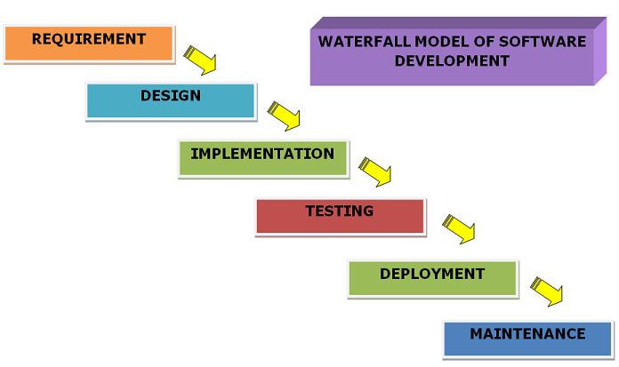
Traditional Software Development
Traditional Software Development is the software development process used to design and develop simple software.
It is used when the security and many other factors of the software are not much important.
It is used by fresher's to develop the software.
It consists of five phases:

Slide 21
Advantages of Traditional Software Development
Well-Established Methodology: Traditional software development follows a well-established methodology that is widely understood and documented.
Clear Requirements: Traditional software development relies on clear and detailed requirements, which helps to ensure that the final product meets the customer’s needs.
Structured Approach: Traditional software development follows a structured approach, with clear phases and milestones, which helps to ensure that the project stays on track.
Proven Success: Traditional software development has a proven track record of success and is widely used in many industries.
Quality Control: Traditional software development typically includes extensive testing and quality control processes, which helps to ensure that the final product is of high quality.
Disadvantages of Traditional Software Development
Slow Process: Traditional software development can be a slow process, with lengthy planning and design phases.
Lack of Flexibility: Traditional software development can be inflexible, with changes to requirements or design difficult to implement once development has begun.
High Cost: Traditional software development can be expensive, particularly if the project is large or complex.
Limited Customer Involvement: Traditional software development often limits customer involvement to the planning and design phases, which can result in a product that does not fully meet their needs.
Limited Innovation: Traditional software development can be conservative and risk-averse, which can limit innovation and the development of new ideas.

Slide 22
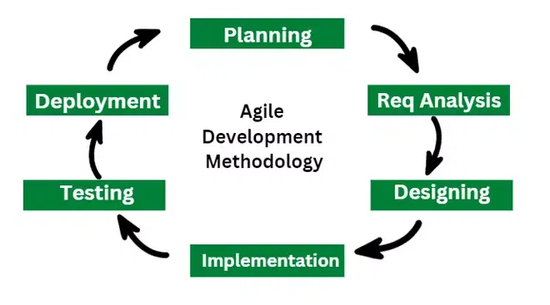
Agile Software Development
Agile Software Development is the software development process used to design complicated software.
It is used when the software is quite sensitive and complicated.
It is used when security is much more important.
It is used by professionals to develop the software.
It consists of three phases:

Slide 23
Advantages of Agile Software Development
Flexibility: Agile software development is highly flexible and can easily adapt to changes in requirements, design, and scope.
Customer Involvement: Agile software development encourages frequent customer involvement, which can result in a final product that better meets their needs.
Continuous Delivery: Agile software development typically includes continuous delivery, which means that working software is delivered to the customer on a regular basis.
Collaboration: Agile software development emphasizes collaboration between team members, which can lead to better communication and problem-solving.
Early and Frequent Testing: Agile software development includes early and frequent testing, which can help to catch issues and bugs early in the development process.
Disadvantages of Agile Software Development
Lack of Predictability: Agile software development can be less predictable than traditional methods, with less certainty about the final product and its delivery schedule.
Limited Documentation: Agile software development often relies less on documentation, which can make it difficult to track changes and understand the system architecture.
Time and Resource Constraints: Agile software development requires a significant commitment of time and resources from all team members.
Less Emphasis on Planning: Agile software development often places less emphasis on detailed planning, which can result in scope creep and delays.
Resistance to Change: Agile software development requires a significant cultural shift and may be difficult for some team members and organizations to adopt.

Slide 24
Difference Between Traditional and Agile Software Development
Traditional Software Development | Agile Software Development
It is used to develop simple software. | It is used to develop complicated software.
In this methodology, testing is done once the development phase is completed. | In this methodology, testing and development processes are performed concurrently.
It follows a linear organizational expectation structure. | It follows an iterative organizational structure.
It provides less security. | It provides high security.
Client involvement is less as compared to Agile development. | Client involvement is high as compared to traditional software development.

Slide 25
It provides less functionality in the software. | It provides all the functionality needed by the users.
It supports a fixed development model. | It supports a changeable development model.
It is used by freshers. | It is used by professionals.
Development cost is less using this methodology. | Development cost is high using this methodology.
It majorly consists of five phases. | It consists of only three phases.
It is less used by software development firms. | It is normally used by software development firms.
The expectation is favored in the traditional model. | Adaptability is favored in the agile methodology.

Slide 26
Examples Office productivity suites Data management software Media players Security programs | Examples Sky Phillips JP Morgan Chase
Models based on Traditional Software Development- Spiral Model Waterfall Model V Model Incremental Model | Models based on Agile Software Development- Scrum Extreme Programming (XP) Crystal Dynamic Systems Development Method (DSDM) Feature Driven Development (FDD) Adaptive Software Development (ASD)

Slide 27
Factors to Consider When Choosing a Project Management Methodology
1. Project Requirements
Understand the specific requirements of your project, including scope, complexity, size and purpose.
Some methodologies work better for particular projects, while others are more flexible and adaptable to various scenarios.
Example
a highly structured and sequential methodology such as Waterfall might work well for projects with well-defined requirements. In contrast, an Agile methodology such as is better suited for projects with conditions that are still evolving.

Slide 28
2. Project Team
Consider your project team’s skills, experience and preferences.
Some methodologies require special skills or training.
Assess whether your team has the necessary capabilities to implement and adhere to a particular methodology effectively.
Ensuring your team is comfortable with the chosen method to improve collaboration and overall project performance is crucial.

Slide 29
3. Flexibility vs. Stiffness
Evaluate the level of flexibility required for your project.
Agile methodologies like Scrum, known for their adaptability, iterative approach, and frequent feedback, make them suitable for projects with evolving requirements.
On the other hand, traditional methodologies such as Waterfall provide a more structured and sequential approach, which can benefit projects with stable and well-defined requirements.

Slide 30
4. Stakeholder Engagement
Determine the required level of involvement and collaboration from project stakeholders.
Some methodologies, such as Agile, emphasize regular stakeholder interaction and feedback throughout the project life cycle.
In contrast, other methodologies may involve stakeholders at certain milestones or less frequently.
Assess the importance of stakeholder engagement in your project and choose the appropriate method.

Slide 31
7.Take Into Account Time and Resource Constraints
Consider your project’s time and resource constraints.
Agile methodologies can be helpful when dealing with changing priorities and tight timelines.
Their iterative nature allows for gradual progress and the ability to adapt to evolving needs.
However, a traditional methodology such as Waterfall may be better if your project has precise requirements, sufficient resources, and a need for predictability.
6. Type of Industry and Project
Consider industry and project type when choosing a methodology.
Different industries may have specific methods that are commonly used and have proven successful.
Research industry best practices and consult with professionals in your field to identify methodologies that align with your industry needs.

Slide 32
7. Risk Tolerance Value
Evaluate your organization's risk tolerance. Agile methodology embraces change and has built-in mechanisms to deal with risks and problems as they arise.
An Agile methodology may be preferred if your organization thrives in an environment that encourages innovation and adaptation. On the other hand, if your project demands a risk-averse approach with careful planning and documentation, a traditional methodology may be more suitable.
8. Evaluation of Organizational Culture
Consider your organization's culture and its readiness to embrace change. Implementing a new project management methodology requires a change in mindset and practice.
Assess whether your organization is open to adopting a new approach or whether a gradual transition is more appropriate. Ensuring that your chosen methodology aligns with your organization's values and goals is essential.

Slide 33
9. Scalability
Determine whether the methodology can be scaled to accommodate larger or multiple concurrent projects.
Some methods are well-suited for smaller projects or specific workflows, such as Kanban or Lean, while others, such as PRINCE2 or PMBOK, are designed for larger, more complex initiatives.
Also, consider whether the methodology can accommodate the growth of your project or handle multiple projects running concurrently.

Slide 34
2.3 Managing and Controlling Projects
Managing scope, time, and resources.
Staffing and coordinating project activities.
Risk management strategies.

Slide 35
Managing and Controlling Projects
The Monitoring and Controlling Process in project management is a method of keeping a project on track and ensuring that appropriate standards and deadlines are met.
The process requires the project manager to collect and understand information about the project, team, and circumstances to make informed decisions.

Slide 36
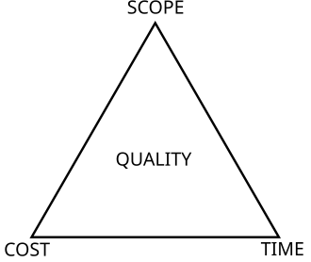
The project management triangle (called also the triple constraint, iron triangle and project triangle) is a model of the constraints of project management.
While its origins are unclear, it has been used since at least the 1950s.
It contends that:
The quality of work is constrained by the project's budget, deadlines and scope (features).
The project manager can trade between constraints.
Changes in one constraint necessitate changes in others to compensate or quality will suffer.

Slide 37
Managing project scope, time, and budget is a challenging aspect of project management.
Here are some practical point :
Define the project scope, goals, and objectives.
Break down the project into smaller tasks and deliverables.
Estimate the time and resources needed for each task and deliverable.

Slide 38
1 Define the scope
The scope of a project is the sum of all the deliverables, requirements, and objectives that the project aims to achieve.
It defines what the project will and will not do, and sets the boundaries and expectations for the project team and the stakeholders.
To define the scope of a project, you need to gather and analyze the needs and expectations of the stakeholders, document the project scope statement, and create a work breakdown structure (WBS).
The WBS is a hierarchical decomposition of the project scope into manageable chunks of work, each with a clear outcome and responsibility.
A well-defined scope will help you avoid scope creep, which is the tendency for the scope to change or expand over time without proper authorization or control.

Slide 39
2 Estimate the time
The time of a project is the duration it will take to complete all the tasks and activities required to deliver the project scope.
It depends on the availability, skills, and productivity of the project team, as well as the dependencies, risks, and uncertainties involved in the project.
To estimate the time of a project, you need to identify and sequence the tasks and activities, assign resources and durations to each task, and develop a project schedule.
The project schedule is a graphical representation of the project timeline, showing the start and end dates, milestones, and critical path of the project.
A realistic and accurate time estimate will help you meet the deadlines, manage the expectations, and avoid delays or overruns.

Slide 40
3 Budget the cost
The cost of a project is the amount of money required to execute and complete the project.
It includes the direct and indirect costs of the resources, materials, equipment, and services needed for the project.
To budget the cost of a project, you need to estimate the costs of each task and activity, aggregate the costs to obtain the total project cost, and allocate a contingency reserve for potential risks or changes.
The project budget is a financial plan that shows the expected income and expenditure of the project, and serves as a baseline for measuring and controlling the project performance.
A realistic and accurate cost budget will help you optimize the use of resources, manage the cash flow, and avoid overspending or underfunding.

Slide 41
Monitor and control
Monitoring and controlling the scope, time, and cost of a project is an ongoing process that involves measuring, comparing, and adjusting the actual performance against the planned performance in order to identify and resolve any issues or deviations that may affect the project quality, scope, time, or cost.
To do this effectively, you need to use various tools and techniques such as
Scope verification,
Scope change control,
Schedule control,
Cost control, and
Earned value management (EVM).

Slide 42
Scope verification ensures that the project deliverables meet the requirements and expectations of stakeholders.
Scope change control manages and documents any changes to the project scope.
Schedule control updates and adjusts the project schedule to reflect the actual progress.
Cost control tracks and manages the project budget. EVM integrates the scope, time, and cost measurements to assess the project performance and progress.
By applying these tips and tools, you can manage your projects effectively and deliver high-quality results that satisfy your stakeholders.

Slide 43
Staffing and coordinating project activities
Staffing and coordinating project activities“
The process of selecting the right people for a project team and then managing their work by assigning tasks, monitoring progress, and ensuring all project elements are working together smoothly to achieve the desired outcome; essentially, it involves recruiting the necessary team members and coordinating their efforts throughout the project lifecycle to meet deadlines and goals.

Slide 44
Key aspects of staffing and coordinating project activities:
Identifying needs:
Analyzing the project requirements to determine the specific skills and expertise needed on the team.
Recruitment:
Selecting qualified individuals from within the organization or through external hiring to fill those roles.
Role assignment:
Clearly defining the responsibilities and tasks for each team member based on their skills and experience.
Project planning:
Creating a detailed project plan outlining timelines, milestones, dependencies, and resource allocation.
Communication management:
Maintaining open communication channels to keep the team informed about progress, updates, and potential issues.

Slide 45
Task delegation:
Assigning specific tasks to team members based on their expertise and workload.
Progress monitoring:
Regularly tracking the progress of each activity against the project plan to identify any deviations or potential problems.
Risk mitigation:
Proactively identifying and addressing potential risks that could impact project success.
Collaboration:
Fostering a collaborative environment where team members work together effectively to achieve shared goals.

Slide 46
Who is responsible for staffing and coordinating project activities?
Project Manager:
Typically takes the lead in staffing a project, assigning tasks, and overseeing overall coordination to ensure the project runs smoothly.
Project Coordinator:
May assist the project manager in day-to-day coordination tasks, including communication, task tracking, and administrative support.

Slide 47
Important considerations when staffing and coordinating project activities:
Team composition:
Building a balanced team with diverse skills and expertise to address all project aspects.
Resource availability:
Ensuring that the required resources (people, budget, time) are allocated appropriately.
Stakeholder management:
Keeping key stakeholders informed about project progress and addressing their concerns.

Slide 48
Risk management strategies include:
Risk identification
Define potential risk scenarios that could impact the organization's ability to conduct business.
Risk analysis
Evaluate the likelihood and potential impact of each risk. A risk heat map can help visualize the nature and impact of risks.
Risk data quality assessment
Ensure that risk management decisions are based on accurate and high-quality information.

Slide 49
Mitigating risks
A common risk response that may be the best option if a risk poses a real threat.
Risk acceptance
Accept that some level of loss is likely to occur and assume not taking any action to mitigate its impact.
Risk avoidance
Eliminate or withdraw from activities or situations that present unacceptable levels of risk.
Monitor risk
Maintain a risk monitoring strategy as part of your plan because new risks constantly emerge.
Risk management is important because it helps organizations understand how to identify and mitigate potential risks.
These risks could have a significant impact on the organization's reputation, financial stability, or result in non-compliance with laws or regulations.

Slide 50
Project management tools

Slide 51
Project management tools help teams stay on schedule, collaborate, and track tasks and issues.
Some of the most popular project management tools include:
Click Up: A free tool with AI that's good for customized task views
Trello: A simple tool with Kanban boards for visualizing workflows
Asana: A tool for team collaboration with unlimited projects and tasks for up to 10 users on the free plan
Wrike: A tool with spreadsheet-like features that's good for managing stakeholders
Miro: A platform for whiteboard-based ideation
Hive: A tool for task management
nTask: A tool for goal tracking
monday.com: A tool for security, brainstorming, and workflow automation
TeamGantt: A tool for visual project timelines
Paymo: A tool for project management with time tracking and invoicing

Slide 52
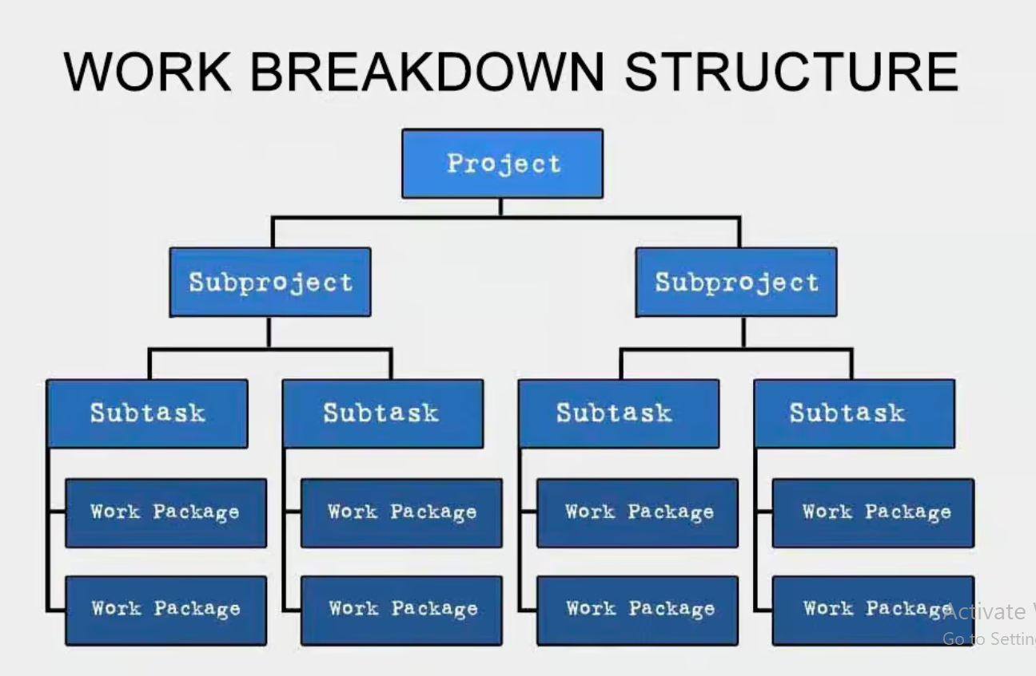
Work Breakdown Structure (WBS)
A Work Breakdown Structure (WBS) is a project management tool used to break down a project's scope into manageable tasks.
creating a hierarchical structure that visually outlines all deliverables, phases, and individual work packages, enabling better planning, organization, tracking progress.
Identifying potential risks within a project by clearly defining the scope and assigning responsibilities to each task.

Slide 53
Important aspects of a WBS:
Hierarchical structure:
The WBS is organized into levels, with the project as the top level, followed by major deliverables, then sub-deliverables, and finally individual tasks.
Work packages:
Each lowest-level element in the WBS represents a "work package," which is a manageable unit of work with a defined scope, responsible person, and estimated duration.
WBS dictionary:
A supporting document that provides detailed descriptions of each work package within the WBS, including deliverables, acceptance criteria, and other relevant information.

Slide 54
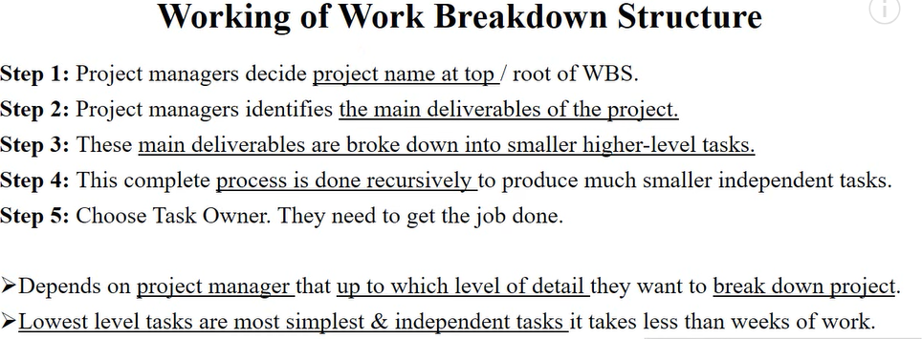

Slide 55
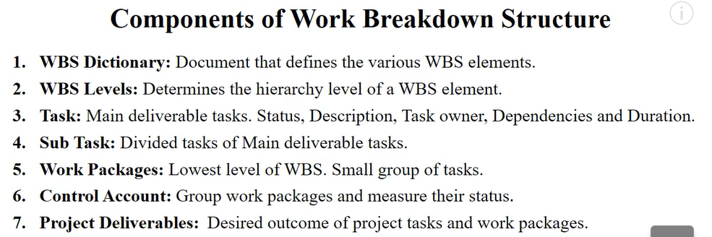

Slide 56
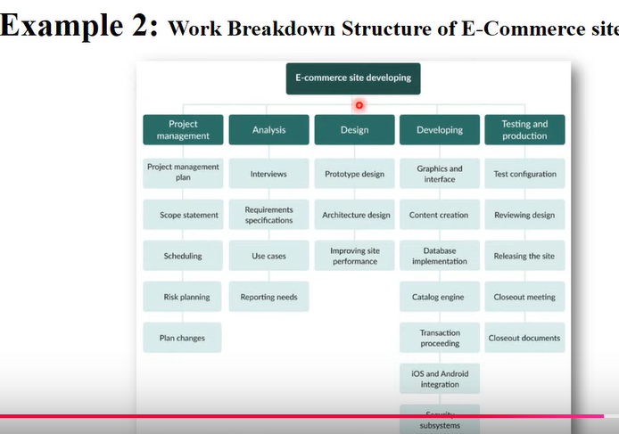

Slide 57
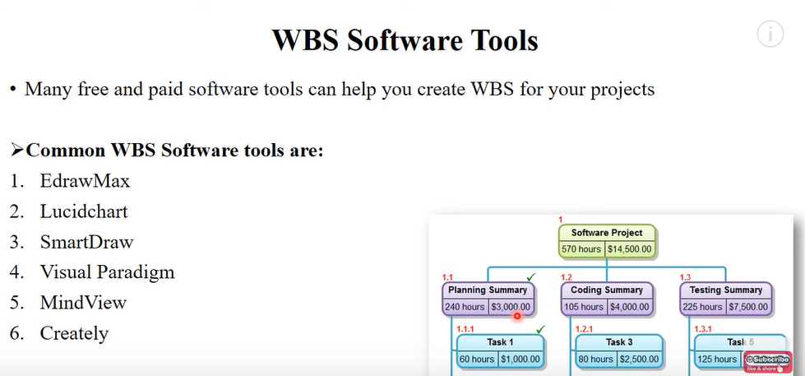

Slide 58
Key uses of a WBS:
Defining project scope:
By breaking down the project into smaller components, a WBS clearly defines what work is included and excluded from the project, helping to manage scope creep.
Planning and scheduling:
The hierarchical structure of a WBS facilitates the creation of a project schedule by identifying dependencies between tasks and allowing for accurate time estimations for each work package.
Resource allocation:
A WBS helps in assigning resources (people, budget) to specific tasks, ensuring efficient utilization of team members and project funds.

Slide 59
Progress monitoring and control:
By tracking the completion status of individual work packages within the WBS, project managers can identify areas where progress is lagging and take corrective actions.
Risk identification and mitigation:
Breaking down a project into detailed tasks allows for early identification of potential risks associated with each work package, enabling proactive risk management strategies.
Communication and collaboration:
A WBS provides a common reference point for all project stakeholders, facilitating clear communication about project goals, responsibilities, and progress.
Cost estimation:
By associating cost estimates with each work package in the WBS, project managers can develop a comprehensive project budget.

Slide 60
Gantt chart
A Gantt chart is a visual tool that helps project managers and teams plan, schedule, and track the progress of a project:
What it is
A bar chart that shows a project's timeline, including tasks, start and end dates, milestones, and dependencies
How it's used
To:
Get a visual overview of the project
See who's responsible for each task
Identify the critical path, or longest path from start to finish
Keep track of progress
Ensure everyone is aware of deadlines and dependent tasks

Slide 61
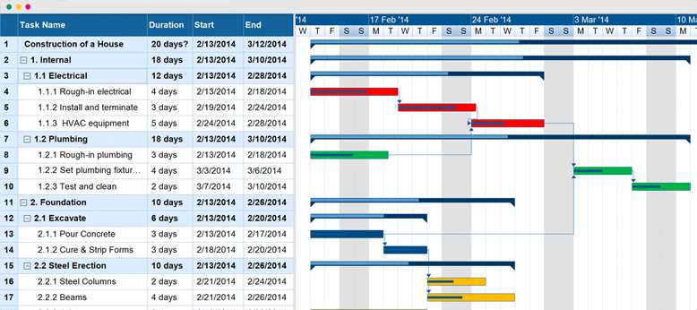
Who uses it
Project managers, team leads, marketers, operations specialists, and more
How to create one
List all tasks and activities
Set a timeline with start and end dates for each task
Identify task dependencies
Assign tasks to team members
Mark milestones
Create a key to indicate critical and non-critical tasks
Draw horizontal bars to represent tasks, with the length of each bar corresponding to its duration
Add arrows between tasks to show their succession constraints

Slide 62
Critical Path Method for Project management
What is the Critical path in project management?
It is a sequence of critical tasks/activities and is the largest path in the project network.
It gives us the minimum time which is required to complete the entire project.
The activities in the critical path are known as critical activities and if these activities are delayed then the completion of the entire project is also delayed.

Slide 63
Benefits of using the critical path method in project management:
Show the project schedule visually.
Highlight important tasks with CPM.
Use CPM to find and handle risks.
CPM helps the project team communicate better.
How to find the critical path in a project:
Step 1: Identify all tasks required to complete the project
Step 2: Determine the sequence of tasks
Step 3: Estimate the duration of each task
Step 4: Draw a network diagram
Step 5: Identify the critical path
Step 6: Calculate the float
Step 7: Monitor the critical path

Slide 64
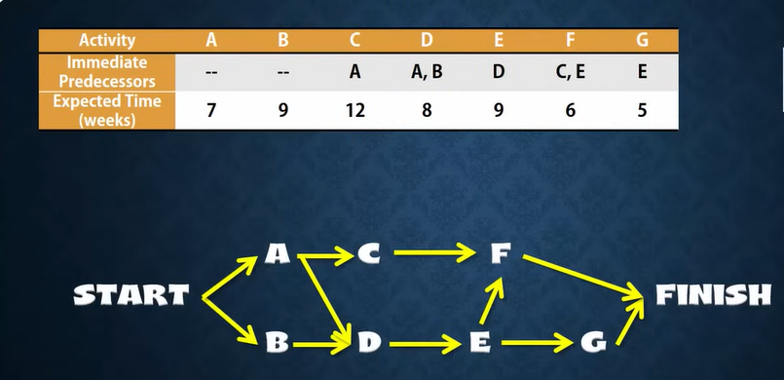

Slide 65
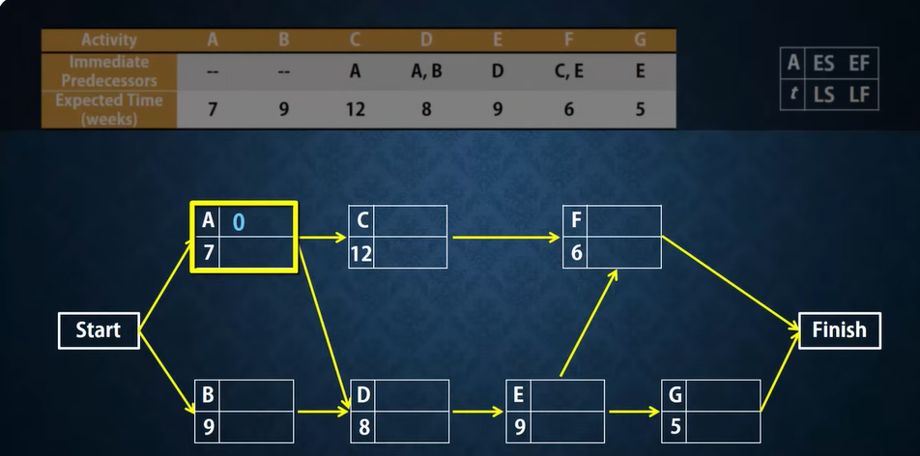

Slide 66
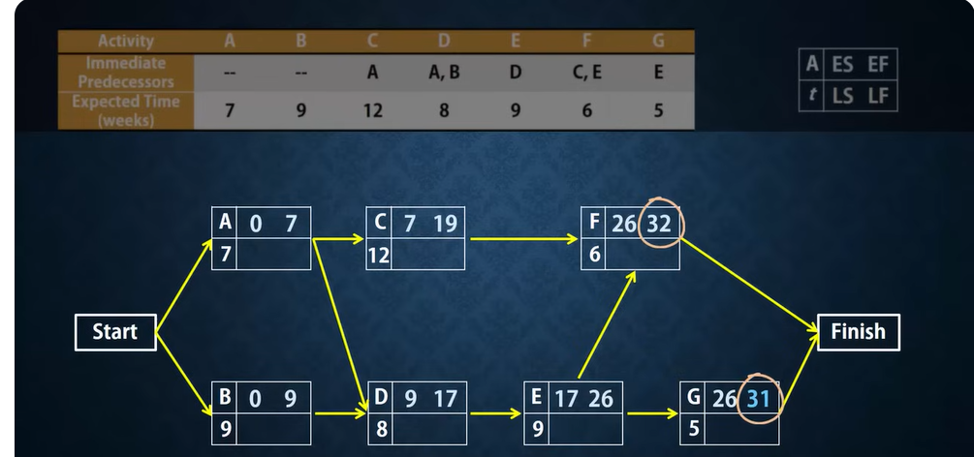

Slide 67
The table given below contains the activity label, its respective duration (in weeks), and its precedents.
We will use the critical path method to find the critical path and activities of this project.
Activity | Duration (in weeks) | Precedents
A | 6 | –
B | 4 | –
C | 3 | A
D | 4 | B
E | 3 | B
F | 10 | –
G | 3 | E,F
H | 2 | C,D

Slide 68
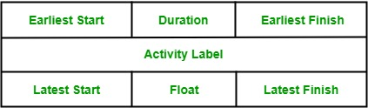
Rules for Designing the Activity-on-Node network diagram:
A project network should have only one start node
A project network should have only one end node
A node has a duration
Links normally have no duration
“Precedents” are the immediate preceding activities
Time moves from left to right in the project network
A network should not contain loops
A network should not contain dangles
Node Representation:

Slide 69
Activity label is the name of the activity represented by that node.
Earliest Start is the date or time at which the activity can be started at the earliest.
Earliest Finish is the date or time at which the activity can be completed at the earliest.
Latest Start is the date or time at which the activity can be started at the latest.
The latest Finish is the date or time at which the activity can be finished at the latest.
Float is equal to the difference between the earliest start and latest start or earliest finish and latest finish.

Slide 70
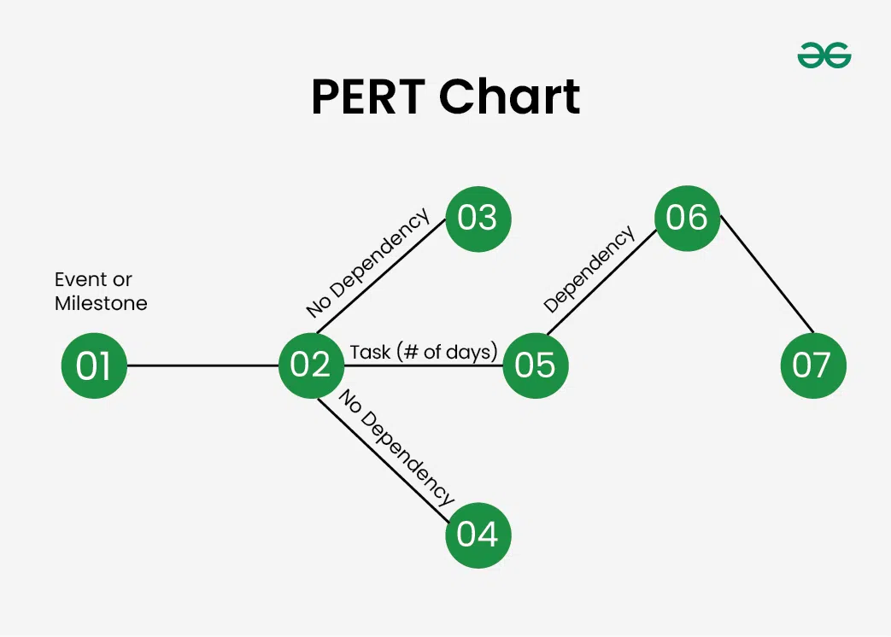
What Is Program Evaluation Review Technique (PERT)?
The Program Evaluation Review Technique, or PERT, is a visual tool used in project planning.
Using the technique helps project planners identify start and end dates, as well as interim required tasks and timelines.
The information is displayed as a network in chart form.

Slide 71
What does a PERT Chart Contain?
Here are the main components of a PERT chart:
Nodes: it represents the task or milestones. every node represents the task name and may also show duration of the task.
Arrows: it indicates the direction or sequence of task and also dependencies between them. suppose an array from A to B, then task A must be completed before task B.
Time Estimation: It estimates the time duration to complete the task.
Critical Path: The critical path is the largest path in project management that always results in the shortest time to complete the project.
Milestones: It is Key point in the project timeline that represent significant events or deadlines.
PERT helps project planners identify
Start and end dates
Anticipated total required completion time
All activities, referred to as events on the chart, that impact the completion time
The required sequence of events
The probability of completion by a certain date

Slide 72
The PERT process
PERT has a set series of steps in mapping out a complex project, which include:
List all the tasks and milestones (a.k.a. events) required for completion of the project
Determine the required sequence of tasks
Design a chart to visually display all the steps
Estimate the time required for each task
Identify the critical path – the longest series of tasks in the project
Adjust the chart to reflect progress made once the project starts
A PERT chart uses numbered circles or rectangles to represent milestones and straight lines with arrows at the end to represent tasks to be completed.
The direction of the arrows, and the numbers, indicate the required sequence.
Typically, the numbers increase by 10 at each milestone, so that new tasks can be added along the way without requiring the whole chart to be redrawn and numbered.

Slide 73
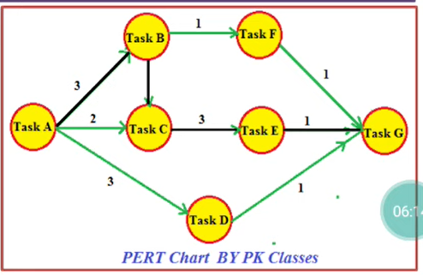

Slide 74
Earned Value Management (EVM)
Earned Value Management (EVM) is a project management technique that systematically measures a project's performance by comparing the planned cost and schedule against the actual work completed, allowing for early identification of potential issues with cost, time, and scope variances, providing a holistic view of a project's progress and health.

Slide 75
Key points about EVM:
Measures three aspects:
EVM integrates cost, schedule, and scope (technical accomplishments) to provide a comprehensive picture of project performance.
Key metrics:
Earned Value (EV): The monetary value of work actually completed.
Planned Value (PV): The budgeted cost of work scheduled to be completed at a given point in time.
Actual Cost (AC): The actual amount spent on work completed.

Slide 76
Calculations for assessing performance:
Cost Variance (CV):
Measures the difference between earned value and actual cost (CV = EV - AC).
Schedule Variance (SV):
Measures the difference between earned value and planned value (SV = EV - PV).
Schedule Performance Index (SPI):
Ratio of earned value to planned value, indicating how well the project is adhering to its planned schedule (SPI = EV / PV).

Slide 77
What is a KPI?
KPI stands for key performance indicator, a quantifiable measure of performance over time for a specific objective.
KPIs provide targets for teams to shoot for, milestones to measure progress, and insights that help people across the organization make better decisions.
Key performance indicators (KPIs) are quantifiable measurements used to measure a company’s overall long-term performance.
KPIs specifically help determine a company’s strategic, financial, and operational achievements, especially compared to those of other businesses within the same sector.
They can also be used to judge progress or achievements against a set of benchmarks or past performance.

Slide 78
Key points
Key performance indicators (KPIs) measure a company’s success vs. a set of targets, objectives, or industry peers.
KPIs can be financial, including net profit (or the bottom line, net income), revenues minus certain expenses, or the current ratio (liquidity and cash availability).
Customer-focused KPIs generally center on per-customer efficiency, customer satisfaction, and customer retention.
Process-focused KPIs aim to measure and monitor operational performance across the organization.
Businesses generally measure and track KPIs through analytics software and reporting tools.

